Slide 1



Slide 2
Motivation
Collaboration
“Most great learning happens
in groups. Collaboration is
the stuff of growth.”
~ Ken Robinson

Slide 3
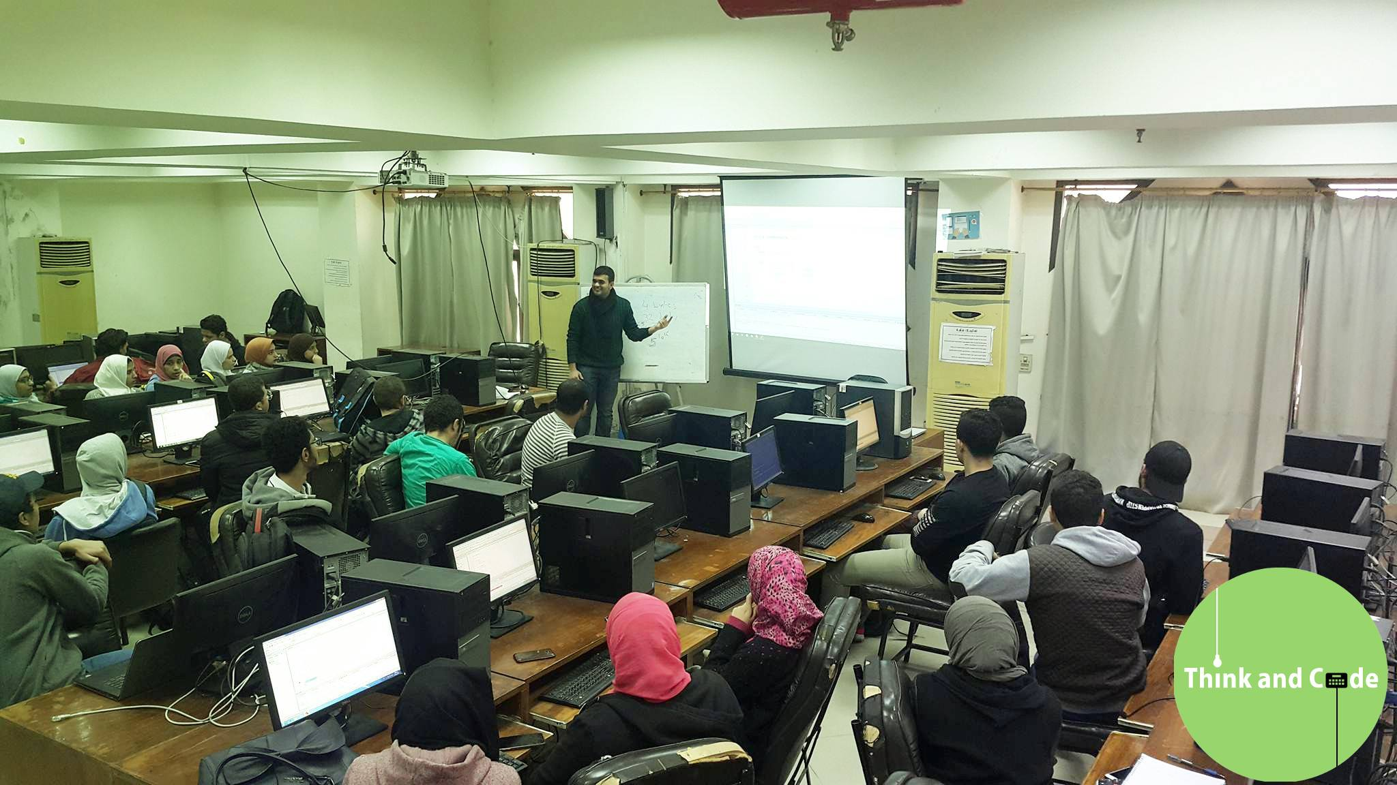
Motivation

Slide 4

Collaborative and Cognitive
Programming Lab

Slide 5
Objective
Personalized Learning
Automated Evaluation

Slide 6
Use-cases
Education
Competitive Programming
Interviews
Remote Pair Programming

Slide 7
Next?
Additional Runtimes
Social Capabilities
Customized Tutorial Planning

Slide 8
Business Model Canvas
Key Partners
Key Activities
Key Resources
Cost
Cairo University
IBM Cloud IaaS / PaaS
Development
Marketing Emails
Customer Support
Maintenance
User Research
Code Base
IBM Cloud Services
Developers
UX Designers
Development
IBM Cloud
Maintenance
Customer Segments
Customer Channels
Customer Relationships
Revenue
Universities
Learners
Tutors
Interviewers
Developers
Universities
Word of Mouth
Social Media
Conferences
Hackathons
Online Tutorials
Customer Support
Premium Subscription
On-premise Deployment

Slide 9






Hacks
pdfmake

Slide 10
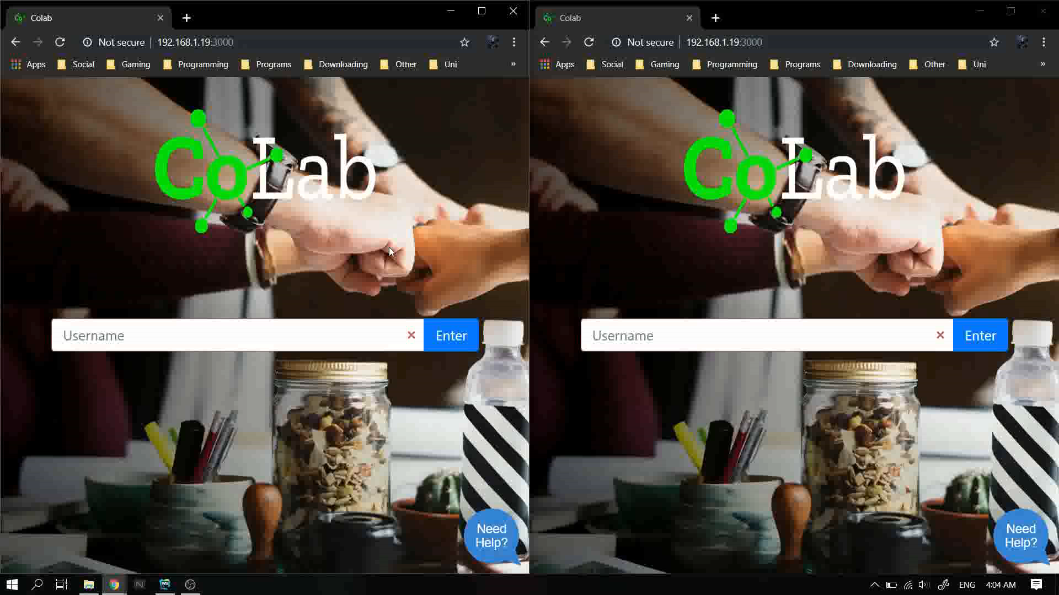
Demo

Slide 11
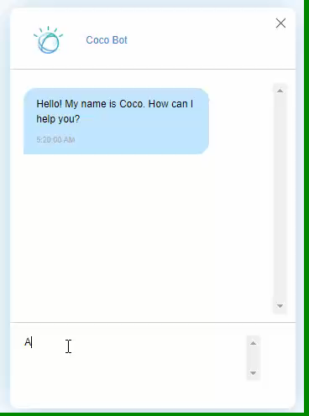
Demo

Slide 12
QUESTIONS?

Slide 13
THANKS ☺

Slide 14
https://github.com/tcg158/colab-lite

